Slide 1



Summer Olympics
View in Power BI
Last data refresh:
12/4/2021 4:25:46 PM UTC
Downloaded at:
12/5/2021 7:05:19 PM UTC

Slide 2
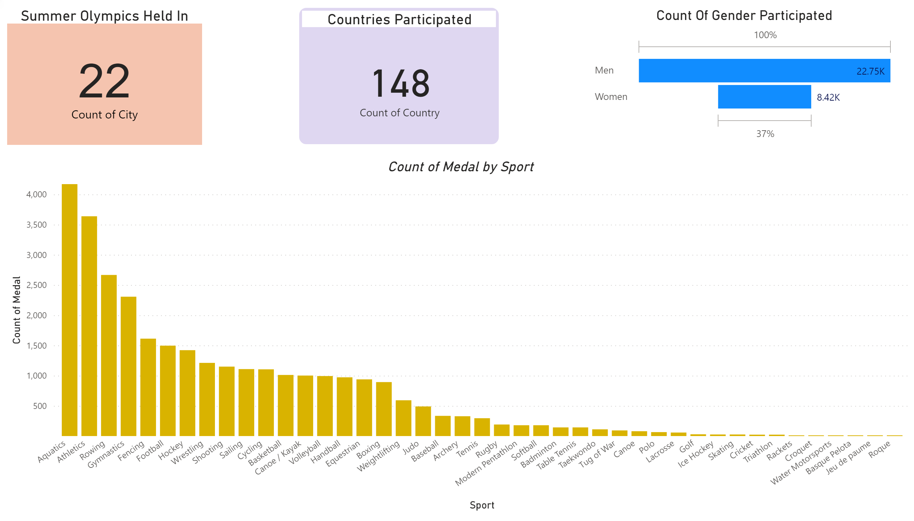
First Page
Notes:
Summer Olympics Held In
No alt text provided.
clusteredColumnChart
No alt text provided.
Countries Participated
No alt text provided.
Count Of Gender Participated
No alt text provided.

Slide 3
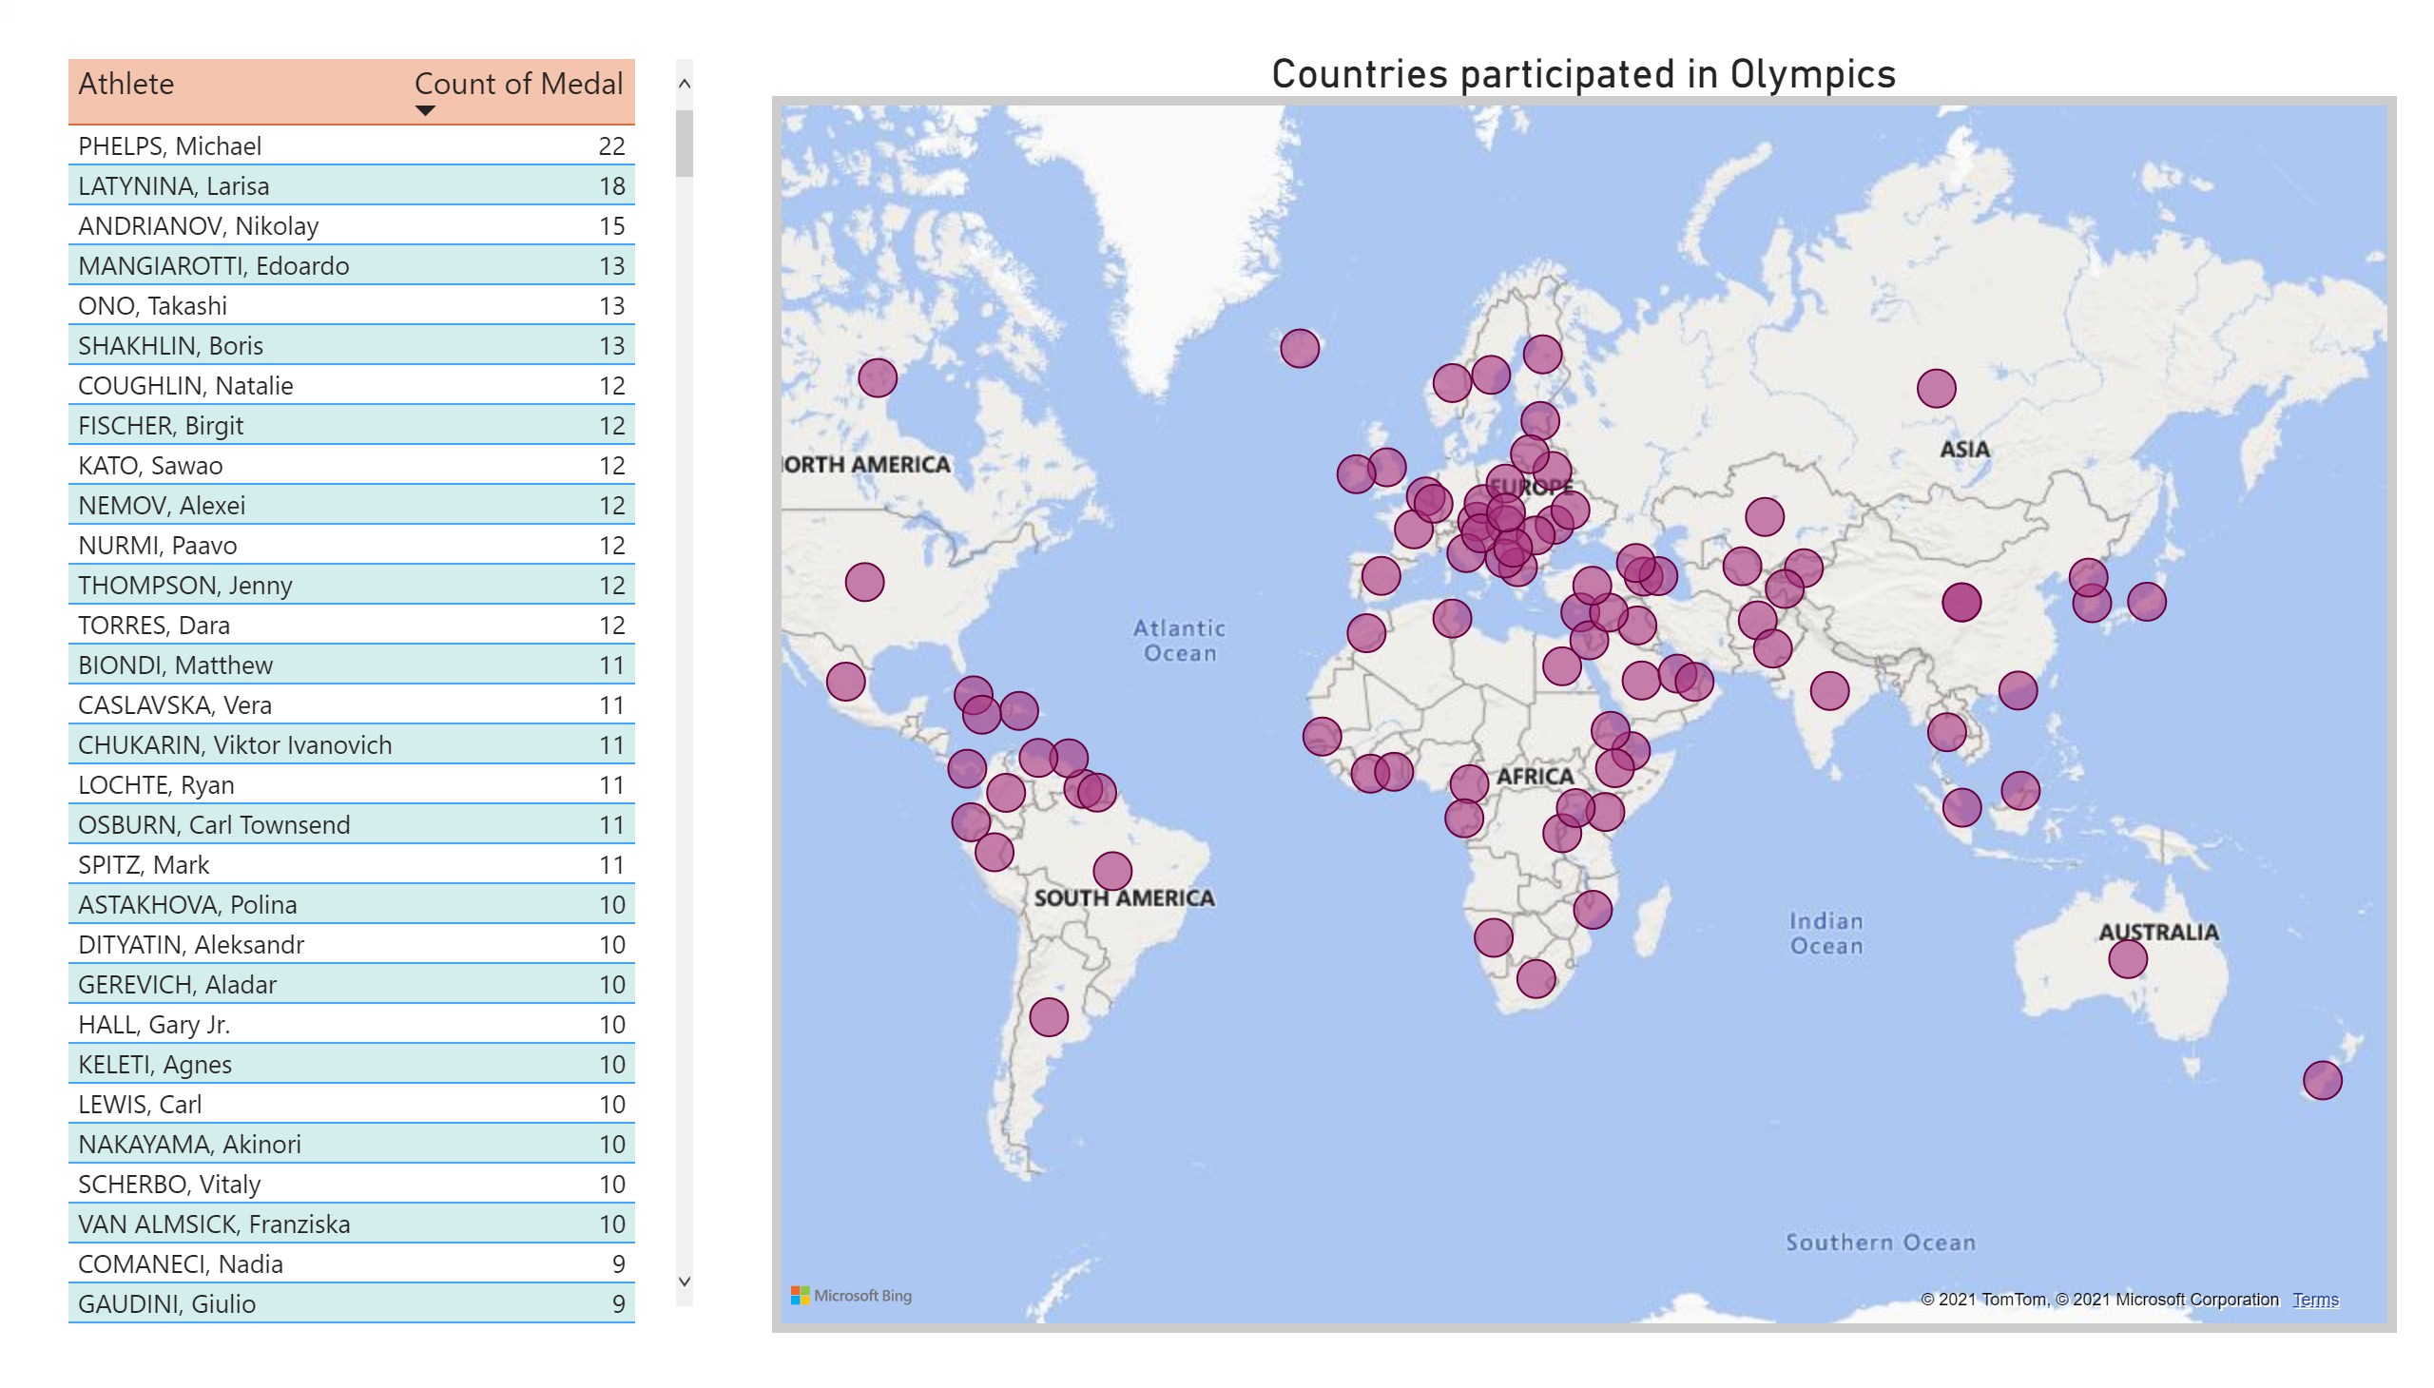
Players and their Countries
Notes:
tableEx
No alt text provided.
Countries participated in Olympics
No alt text provided.

Slide 4
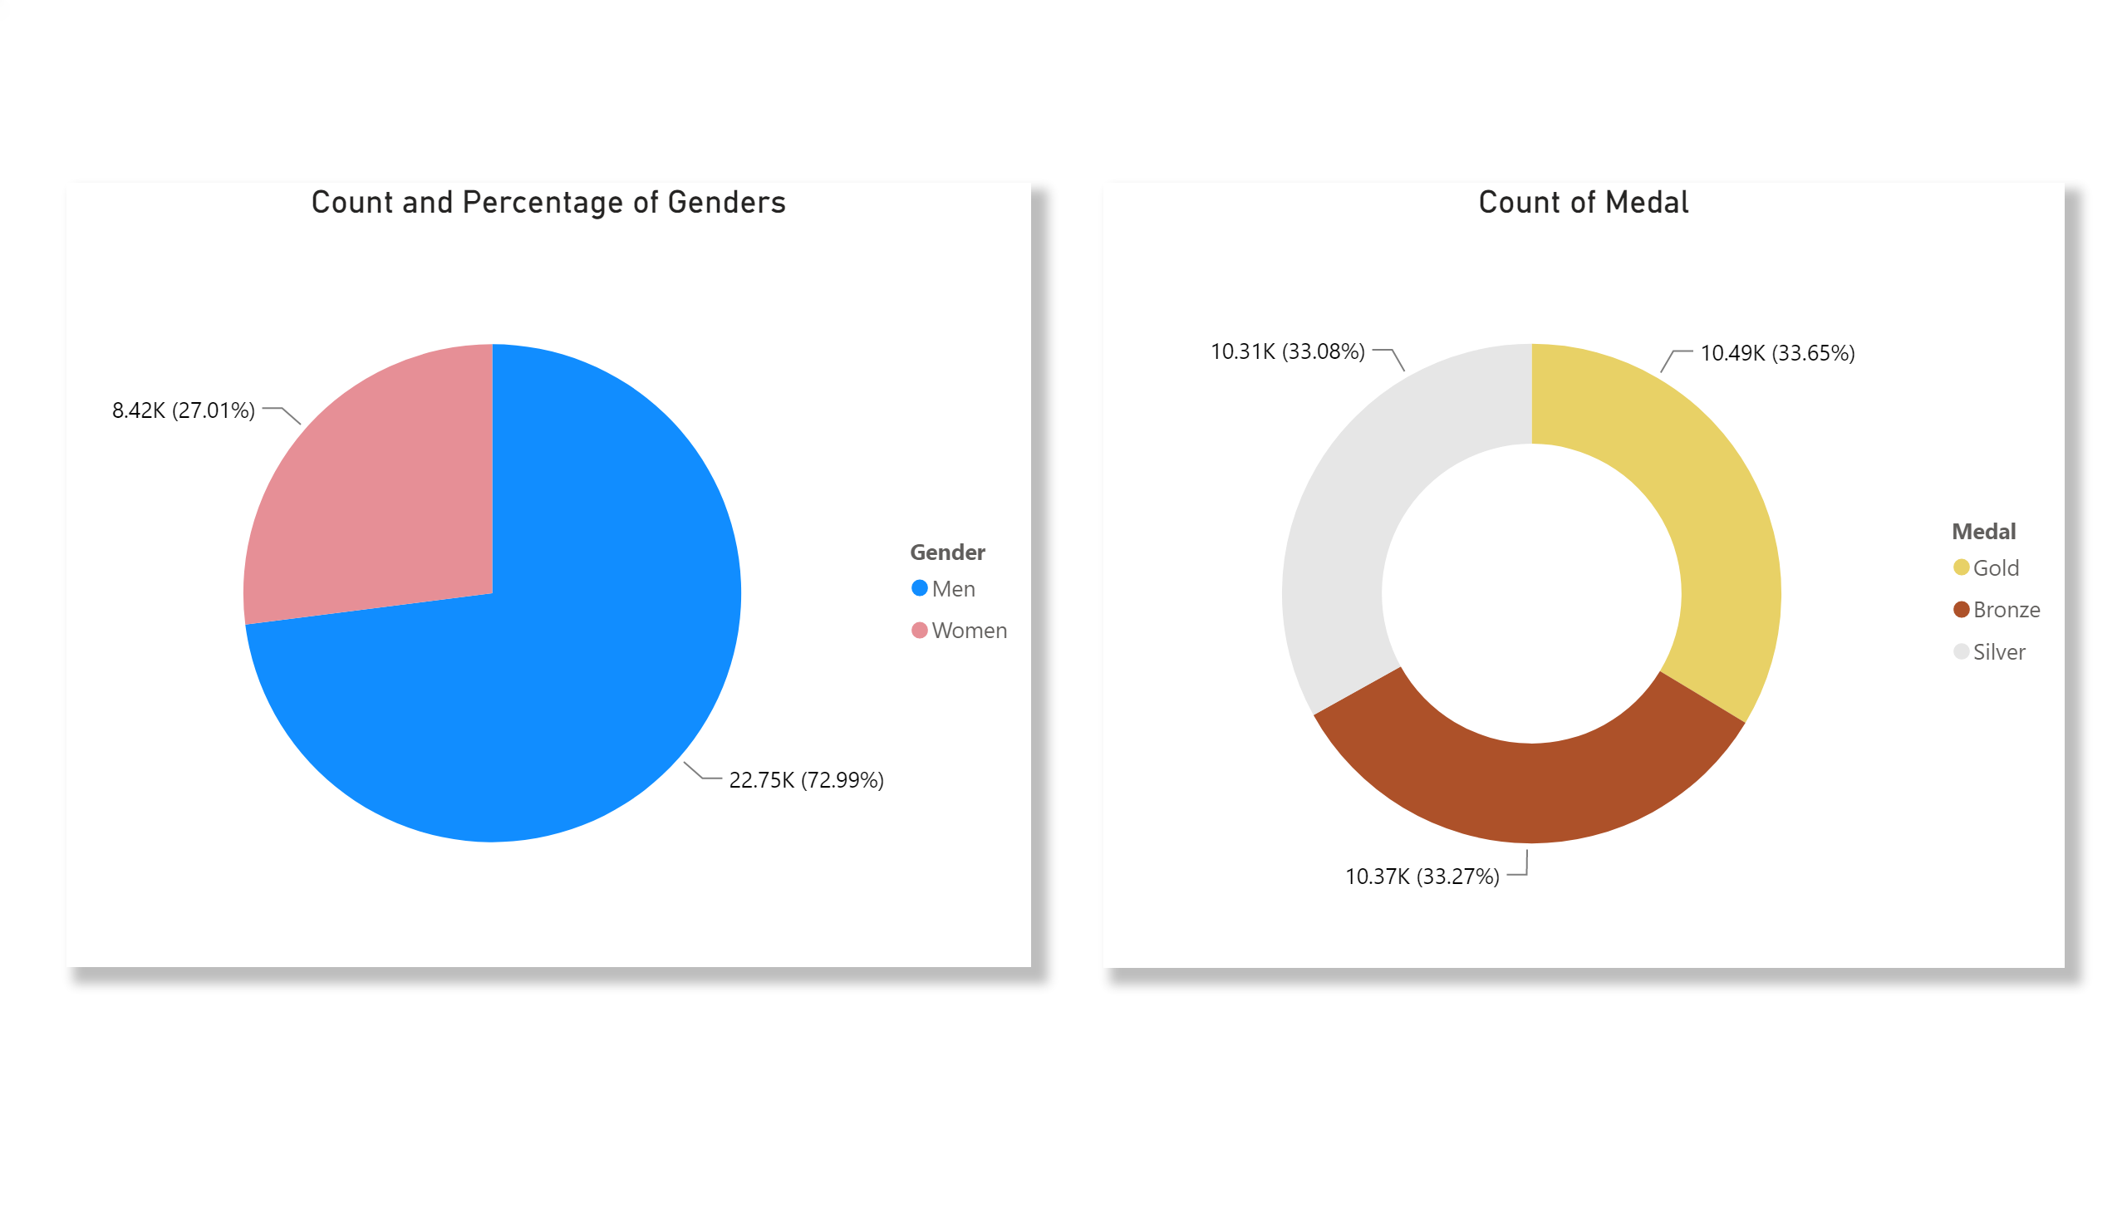
Gender with their medal count
Notes:
Count and Percentage of Genders
No alt text provided.
Count of Medal
No alt text provided.

Slide 5
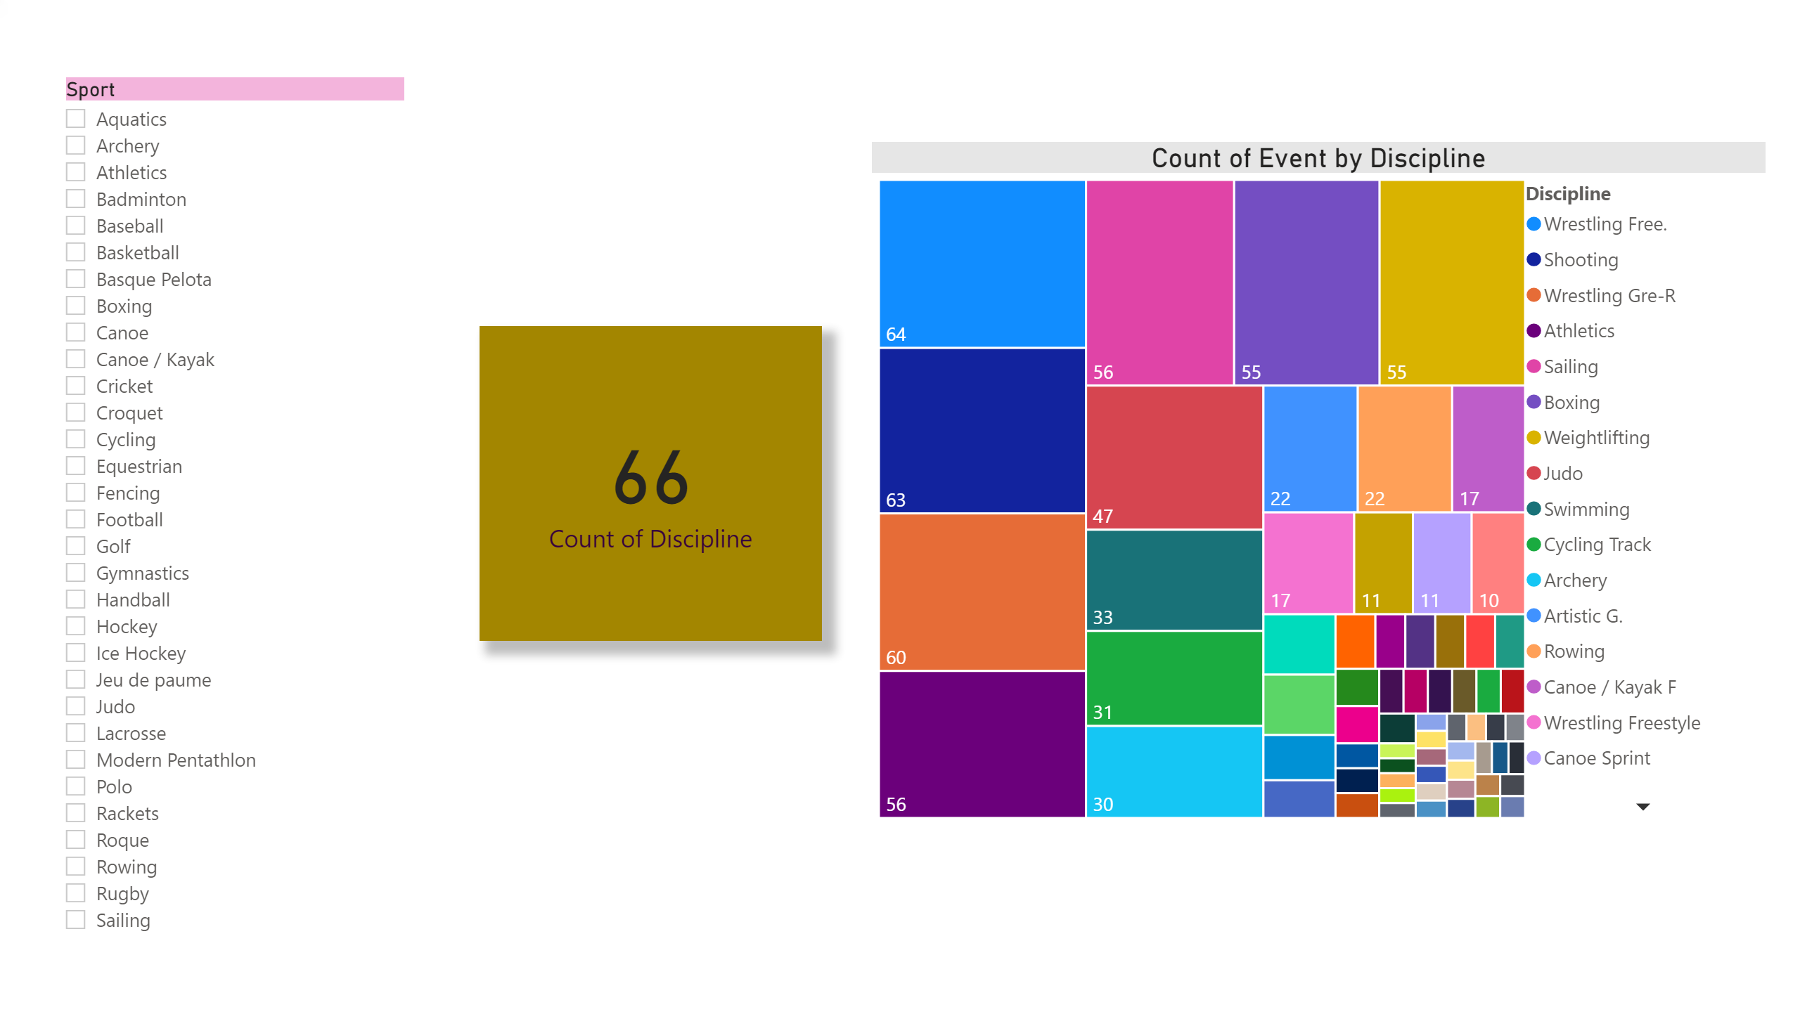
Sports,Discipline and their Events
Notes:
card
No alt text provided.
treemap
No alt text provided.
slicer
No alt text provided.

